Slide 1

Tokenblocks
Data Transparency in Fund Investment

Slide 2

Notes:
https://www.morningstar.com/content/dam/marketing/shared/pdfs/Research/USFundFeeStudyApr2018.pdf?cid=EMQ_
http://www.usfunds.com/investor-library/frank-talk/are-we-headed-for-a-passive-index-meltdown/#.W_QxzxP7TxU

Slide 3

$300,000,000
$15k per day
Notes:
https://www.morningstar.com/content/dam/marketing/shared/pdfs/Research/USFundFeeStudyApr2018.pdf?cid=EMQ_
http://www.usfunds.com/investor-library/frank-talk/are-we-headed-for-a-passive-index-meltdown/#.W_QxzxP7TxU

Slide 4




Custodian
Transfer Agent
Investor
Fund
1
Lack of Transparency
2
Poor Communication
3
Error Propagation
Notes:
https://www.morningstar.com/content/dam/marketing/shared/pdfs/Research/USFundFeeStudyApr2018.pdf?cid=EMQ_
http://www.usfunds.com/investor-library/frank-talk/are-we-headed-for-a-passive-index-meltdown/#.W_QxzxP7TxU

Slide 5
Globally - £3bn
Europe – £1.5bn
UK - £100mn
Notes:
https://www.ey.com/Publication/vwLUAssets/ey-global-etf-survey-2017/$FILE/ey-global-etf-survey-2017.pdf

Slide 6

Notes:
https://www.ey.com/Publication/vwLUAssets/ey-global-etf-survey-2017/$FILE/ey-global-etf-survey-2017.pdf

Slide 7

Notes:
https://www.ey.com/Publication/vwLUAssets/ey-global-etf-survey-2017/$FILE/ey-global-etf-survey-2017.pdf

Slide 8

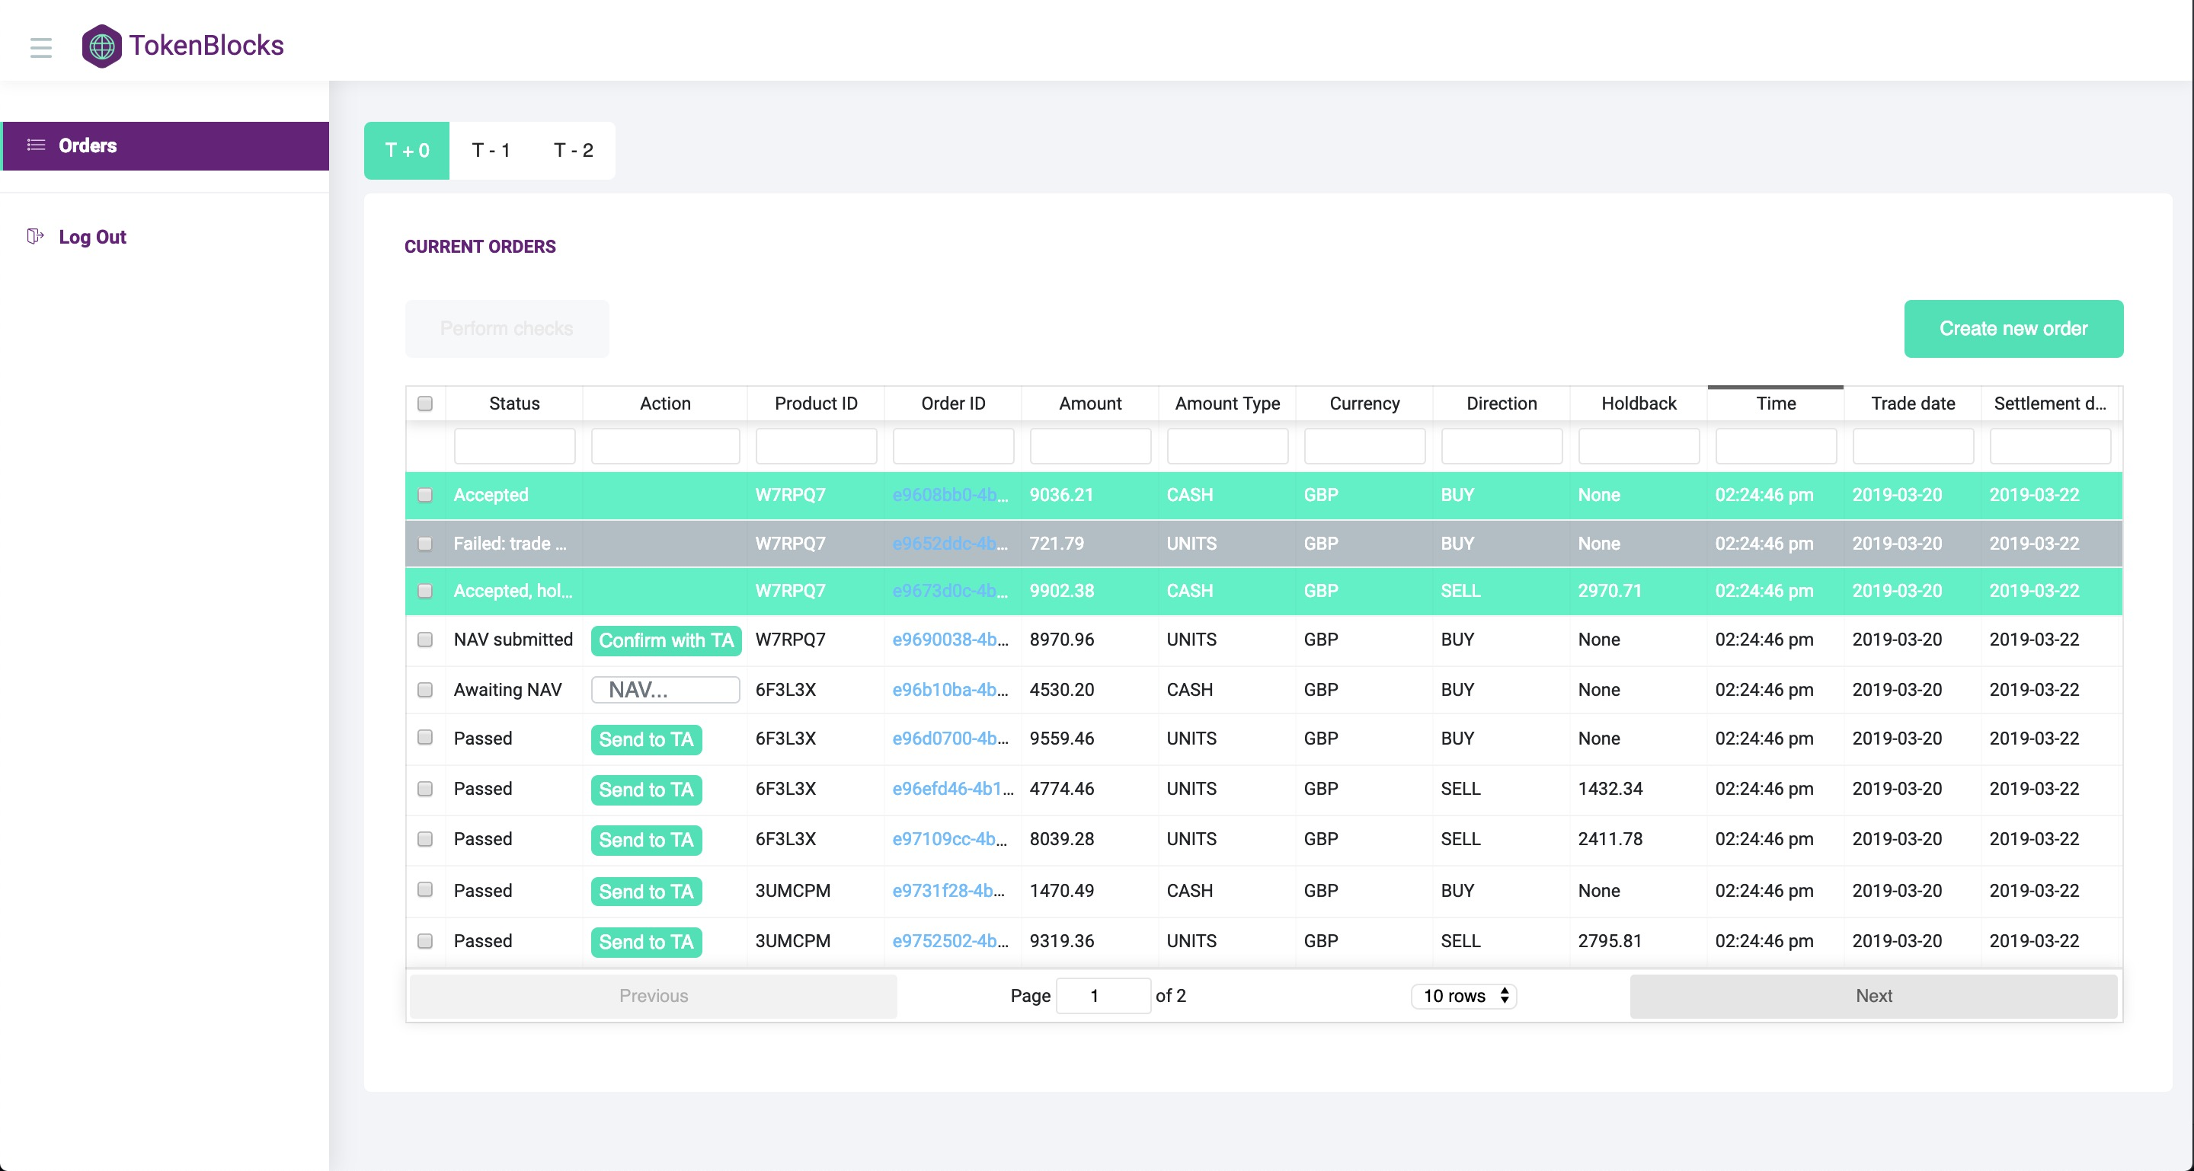

Notes:
https://www.ey.com/Publication/vwLUAssets/ey-global-etf-survey-2017/$FILE/ey-global-etf-survey-2017.pdf

Slide 9




Investor
Custodian
Transfer Agent
Hedge Fund

Slide 10
Transfer Agent
Hedge Fund
Investor
Custodian

Slide 11








Phil - CEO
Tom - CTO

Slide 12
Accelerator
Market Fit
Seed
Sandbox
Top 3 largest HF investor in the UK
£250,000

Slide 13
Tokenblocks
For a demo please contact phil@tokenblocks.io

Slide 14
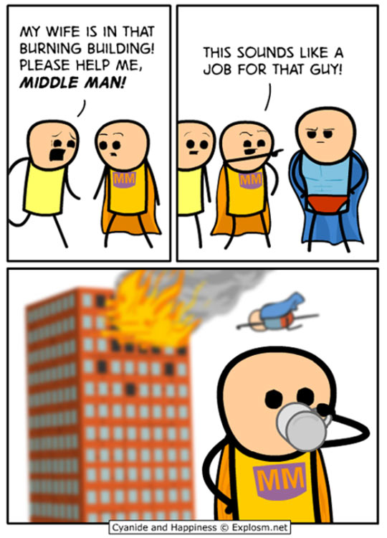

Notes:
https://www.morningstar.com/content/dam/marketing/shared/pdfs/Research/USFundFeeStudyApr2018.pdf?cid=EMQ_
http://www.usfunds.com/investor-library/frank-talk/are-we-headed-for-a-passive-index-meltdown/#.W_QxzxP7TxU

Slide 15
Top 3 largest HF investor in the UK
£500,000

